Slide 1
Progress Update
19th January 2006
Andrew McVeigh

Slide 2
Main aim of research
To allow multiple extensions to a system to be automatically merged, or…
To automatically detect merge problems and to guide the creation of a further extension which resolves the problems
Combined system
(no problems)
(2) Resolved system
X3
X1
X2
or
X1
X2
System
System

Slide 3
Applications of merging
Context is the Backbone model
  Can model extensions to apps, f’works and plugins
Applicable to framework / plugin architectures that combine multiple extensions (e.g. eclipse)
  Many other examples
Applicable also to system evolution??
  Can be applied recursively…
X1
X2
System at t1
System at t2
System at t0
X3
X4

Slide 4
Breaking the problem down…

Slide 5
Sub-problems
Backbone ADL
  Structural representation
  Behavioural representation
    Use FSP to represent protocols: white-box vs black-box
    Modelling the state pattern
  Redefinition
    Feature removal and addition
    Checking for correct composition, conformance
  Graphical representation
  Other issues
    Concurrency model, versioning,
Combining extensions
  Just starting out…
Highly related
concepts
Currently here

Slide 6
Behavioural Representation

Slide 7
Behavioural representation
Want to reason about:
  Correctness of composition
  Is system still well formed after feature removal
  Black-box vs white-box behaviour (recursive approach)
Protocols give me this…
  Request / response and receive / reply
  Papers:
    “Behaviour protocols for software components” [Plasil et al]
    “System architecture: the Context for …” FSE, [Uchitel et al]
  FSP works well here
    Behaviour protocols don’t seem to add anything over this…
    Use FSP to specify the protocols of a component based on port interactions

Slide 8
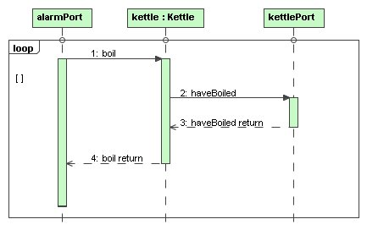
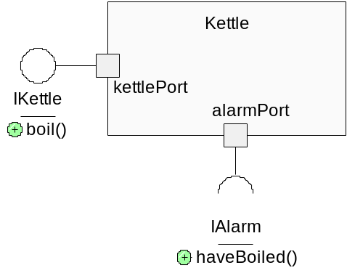
Behavioural representation (2)
Use a subset of UML2 sequence diagrams and translate into FSP
Hide internals using @ or / to get black-box view
  Allow specification of black-box protocol for top-down development
Translate to FSP
Prot_Kettle =
(kettlePort.receive.request.boil ->
alarmPort.send.request.soundAlarm ->
alarmPort.receive.response.soundAlarm ->
kettlePort.send.response.boil -> Prot_Kettle).

Slide 9
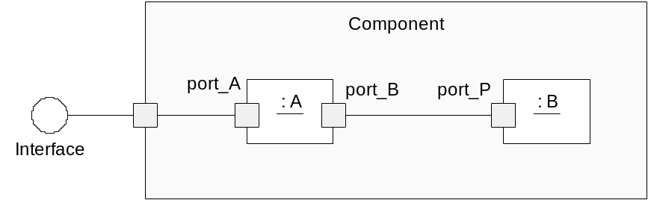

Behavioural representation (3)
Combining works nicely via composition
  Rename bound ports & reverse polarity of 1 side (send -> receive & vice versa)
  Can also omit internal events using @ or / to go from white box to black box ➔ scalable…
Black box LTS
Prot_A = (port_a.rx_request.first -> port_b.tx_request.second -> port_b.tx_request.third ->
port_b.rx_response.second -> port_a.tx_response.first -> Prot_A).
Prot_B = (port_p.rx_request.second -> port_p.tx_response.second -> Prot_B).
||Renamed_Prot_B = (Prot_B)
/{internal.port_bp.request/port_p.rx_request, internal.port_bp.response/port_p.tx_response}.
||Renamed_Prot_A = (Prot_A)
/{internal.port_bp.request/port_b.tx_request, internal.port_bp.response/port_b.rx_response}.
||Architecture_Prot = (Renamed_Prot_A || Renamed_Prot_B).
||External_Architecture_Prot = (Architecture_Prot) \{internal}.

Slide 10
Behavioural representation (4)
Using this we can:
  Check for send and receive interleaving
    Just compose a protocol with Check = receive -> send -> Check etc.
  Check for incorrect composition (Plasil, many other)
    Get deadlocks if protocols don’t sync up
    Get deadlocks if we have “no completion” problems
  Check for protocol compliance
    Black-box versus white-box for top-down development
    Is there an LTS conformance check possible for 2 protocols?
  Check if feature removal is allowed (Adamek & Plasil)
    Put in a empty component to analyse the removed feature
      Has null protocol
    We can also put in shell component, with default receive / response protocol
    to reason about shelling out the component & its effect
  This lets us work out the subgraph of a component that can be safely removed.

Slide 11
What about HMSCs?
Limit sequence diagrams to give us the expressive power of bMSC and hMSC
  May need extra limitations to fit into FSP model
  Currently saying nothing about state
Worries
  Am I just going over Darwin + Tracta? Need to look into…
So, protocol of a component is the ||composition of internal parts, with @hiding
  But, is there more we can say to generate strict sequential composition when we know this to be true?...

Slide 12
Modelling the state pattern
Adding design intuitiveness

Slide 13
The control problem (1)
Want to support a way of designing that is intuitive to me ☺
  I want to design components with one or more internal state machines
  Harel state machines are not composable ☹
  Can I translate a subset of state machines into FSP?
  How does this fit in with behaviour protocols?
  Solution: look at a way of supporting the state design pattern using the ADL

Slide 14
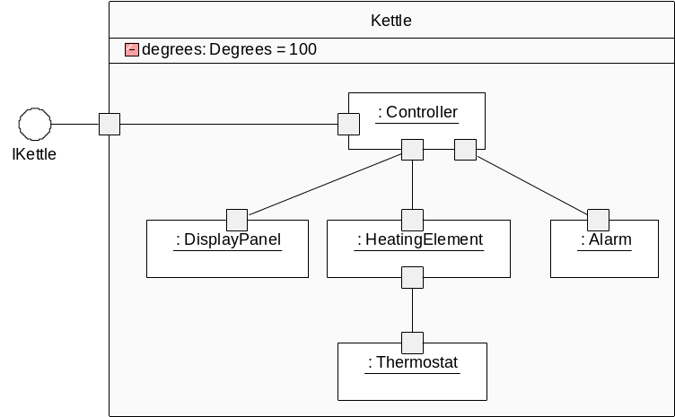
The control problem (2)
In practice, I find that composite components tend to have a big chunk of control logic which coordinates the behaviour
How can I factor this into smaller bits?
  Motivation is to help with reuse
  If we can replace or reconfigure a small bit of the control logic, the component is more reusable…
How can we
decompose this?

Slide 15
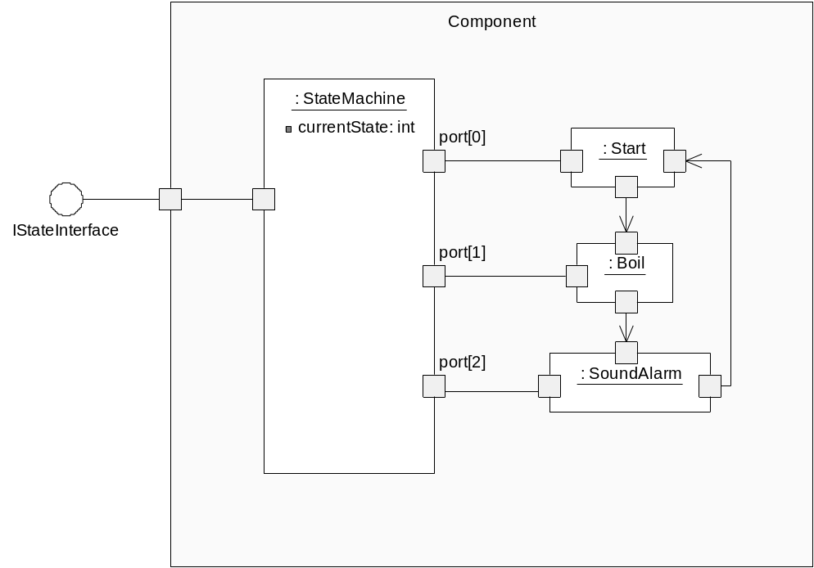
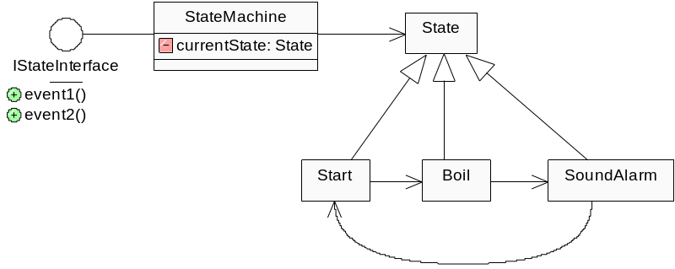
Solution: A structural form of the state pattern
Break up the logic into smaller components, each of which has a protocol
  Guarantee that only one component is dispatched to at any one time
The ADL way
The OO way…

Slide 16
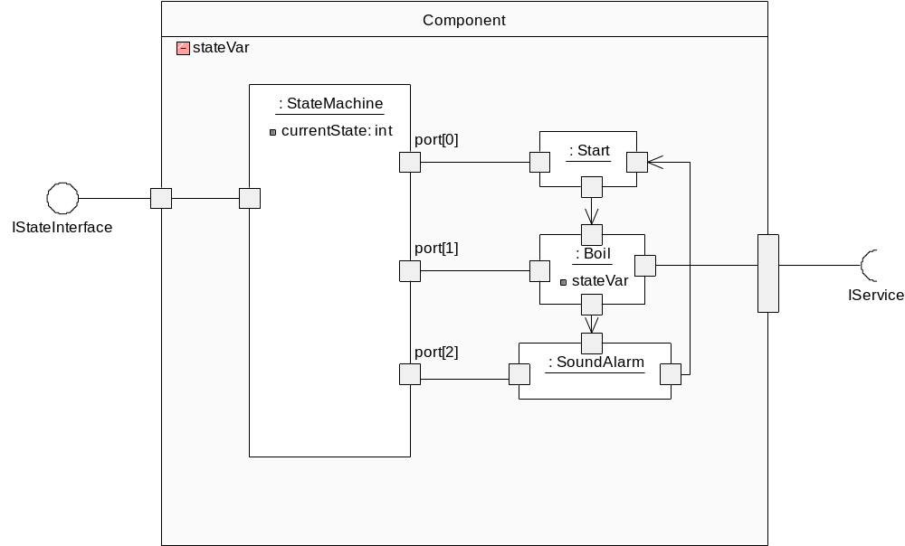
The state pattern in practice
Usually, individual states may need to
  Share a common view of the composite state
  Access services in the composite component

Slide 17
The state pattern in practice (2)
If we ensure that certain interactions do not happen, we get
  A sort of cross between hMSC and statecharts that guarantees strict sequential composition
  (easy to turn into FSP)
  An intuitive way to design, that correlates directly to my current case tool implementation
  A way to decompose the control logic of a component into more granular parts
NOTE: need to push logic about next state out of the current state…
Related question:
  What is the concurrency model for Backbone?

Slide 18
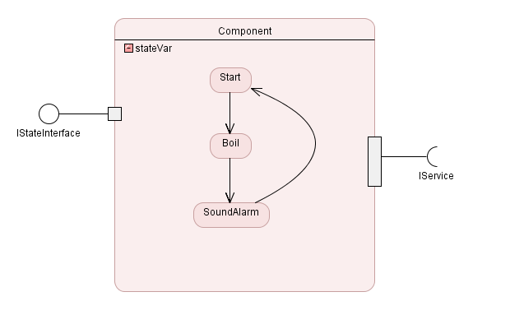
Adding graphical syntactical sugar…
Can use multiple views & elide connections & state machine component in main view
Can use visual styles to make intent more obvious
We get an
equivalent
representation

Slide 19
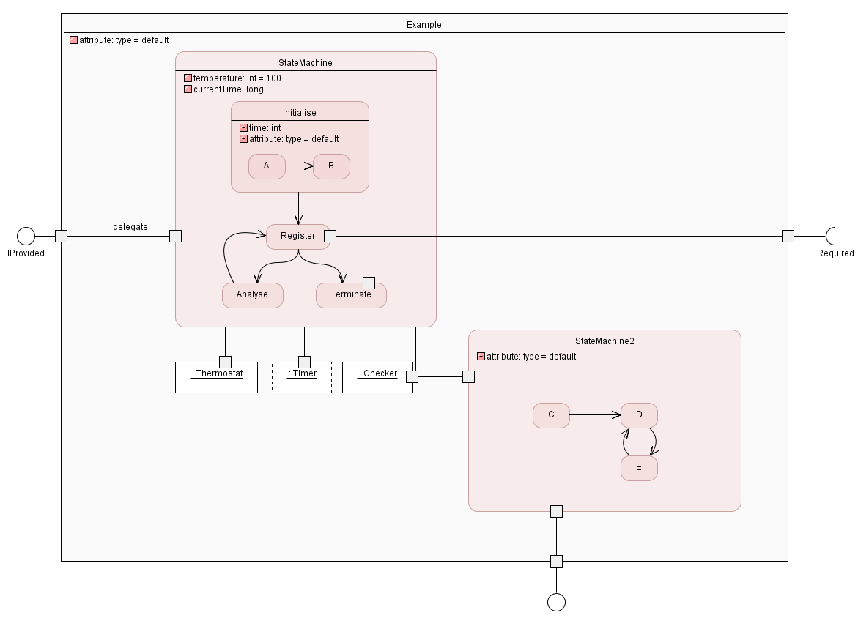
Example…

Slide 20
What it allows…
A structural form of decomposition of control logic
  Similar to state charts for designing
  Simple mapping back to FSP for composition
  Possible to include these components in redefinition, subject to limitations…
    The more granular an architecture is, the more reusable
Other logic patterns are possible
  Mine current case tool for this
  Do later…

Slide 21
Combining multiple extensions
Just starting to look into now
  Background of the component model is mostly there
Have had some (small) insights
  Flattening entire graph and looking at overlaps
  Wrapping for feature addition works nicely
  Can reason about feature removal
  Can use protocols to check replacement for placeholders
    Even if they are not the same “shape”
Big question:
  can we merge without knowing about specific features and how they map onto the implementation?

